Slide 1

World Population Analysis
-By
-PRUTHVI RAJ KN
-4TH BCA ‘A’
-BCA232661
-Data Analysis

Slide 2
DATASET OVERVIEW
The dataset comprises three tables
Table 1 : Covers global population data from 2000 to 2049
Table 2 : Continues from 2040 to 2099, focusing on male and female population by age group and country.
Table 3 : Contain country-to-continent mapping,along with corresponding region and country codes.

Slide 3
TOOL USED
Microsoft Power BI

Slide 4
DATA CLEANING
Corrected data types for mismatched columns.
Renamed columns with clear, descriptive names.
Replaced month based age entries with numerical age group values.
Scaled male and female population figures by 1000 and rounded them.
Removed irrelevant columns.
Pivoted gender-based population columns.
Merged the two similar tables for a unified dataset.

Slide 5
DATA MODELLING
Established one-to-many relationships.
Fact Population served as fact table.
DimRegion and DimAge were set as dimension tables.

Slide 6
DATA ANALYSIS
Total number of countries.
Average population.
Running total of population.
KEY FINDINGS
Total population : 943 billion
Number of countries : 194
MOST POPULATED REGION
Highest : Asia
Second Africa
Lowest : Oceania

Slide 7
FINDINGS

Slide 8
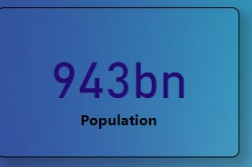
KPI (Key Performance Indicator) for Total Population

Slide 9
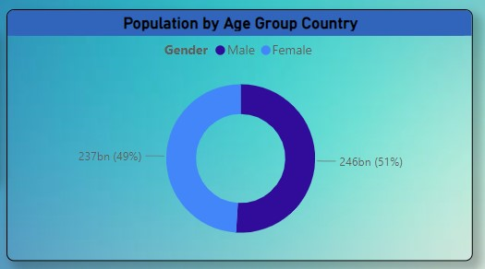
What is the composition of the male and female population worldwide ?
Across the world, the male and female population are distributed equally with only slight variations.

Slide 10
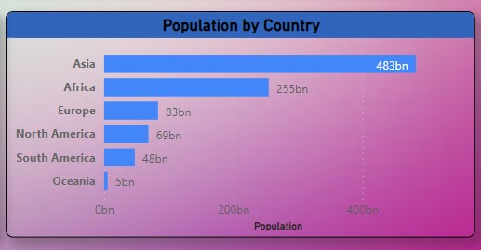
Which region is highly populated?
Among all the region Asia is the most populated, followed by Africa in second place, while Oceania is the least populated.

Slide 11
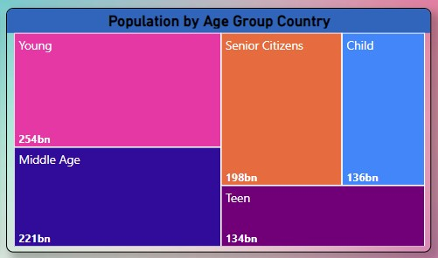
Which age group category has the highest population ?

Slide 12
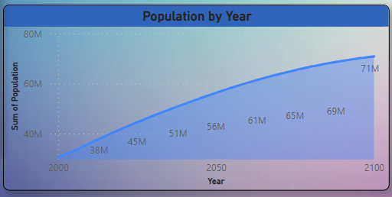
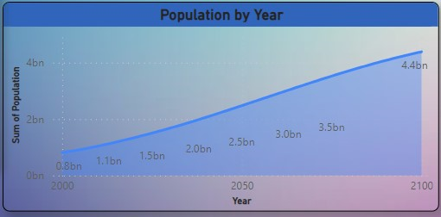
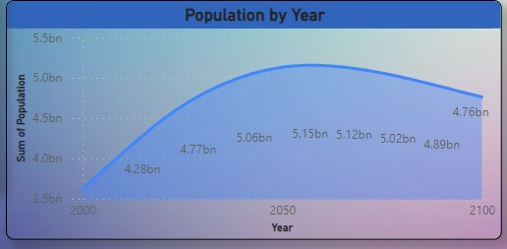
What are the population trends across all regions over the years ?
Oceania
Africa
Asia

Slide 13
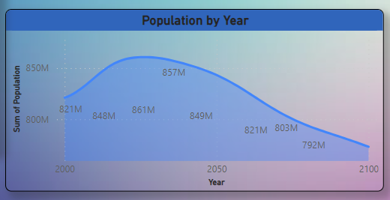
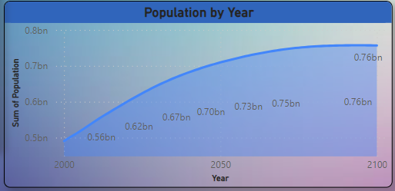
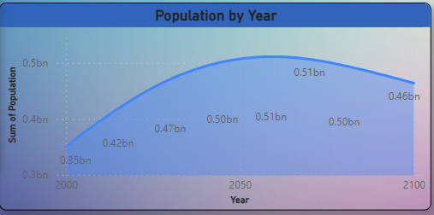
Europe
North America
South America

Slide 14
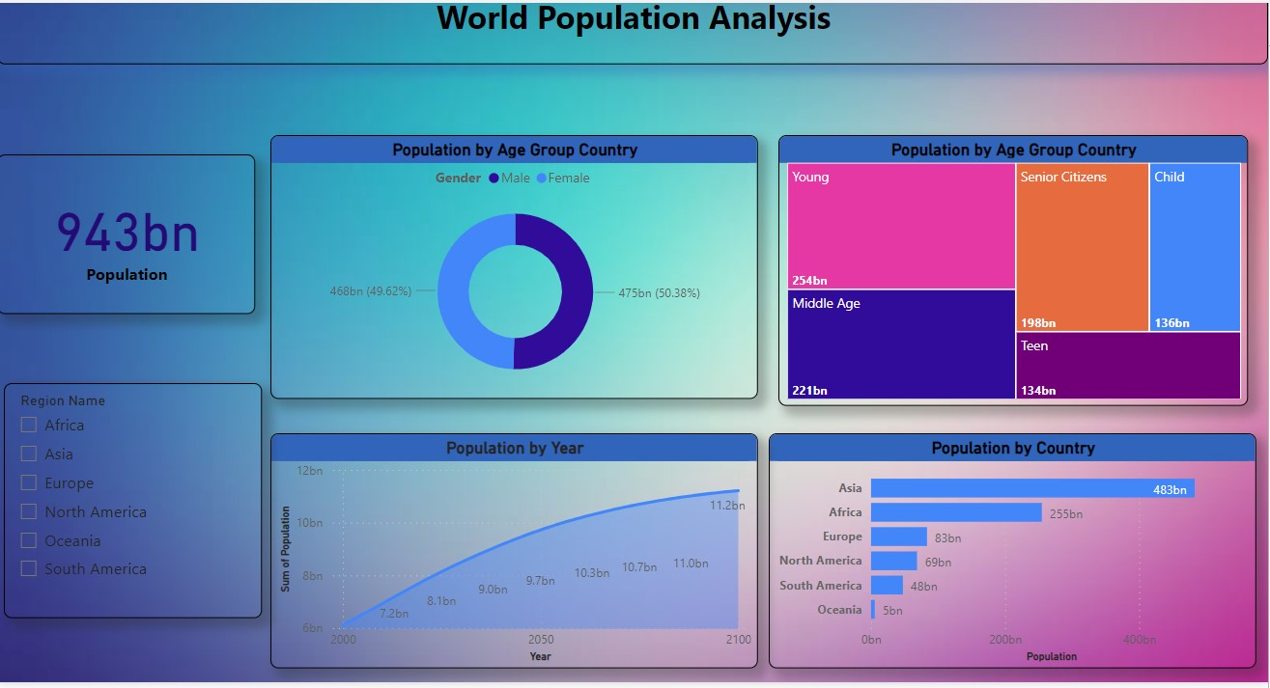
World Population Analysis

